Slide 1
Chapter Eight
Choice between Consumption and Leisure

Slide 2
Structure
Understand labor supply behavior: choice between consumption and Leisure
Comparative Statics of labor supply

Slide 3
Labor Supply
A worker is endowed with $m of nonlabor income and R hours of time which can be used for labor or leisure. ω = (R, m).
Consumption good’s price is p_{c}.
w is the wage rate.
⎯
⎯

Slide 4


Labor Supply
The worker’s budget constraint is
where C, R denote gross demands for the consumption good and for leisure. That is
⎯
⎯
{
{
expenditure
endowment
value

Slide 5
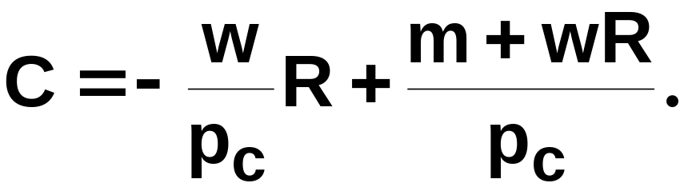
Labor Supply
⎯
rearranges to
⎯

Slide 6
Labor Supply
($)
C
m
endowment
⎯
R
R

Slide 7
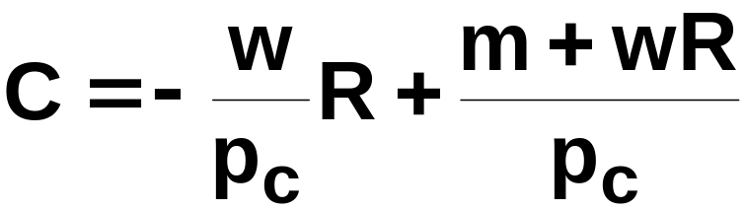
Labor Supply
C
⎯
m
endowment
⎯
R
R

Slide 8
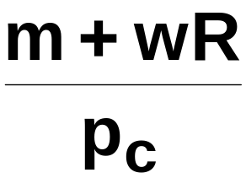
Labor Supply
C
⎯
⎯
m
endowment
⎯
R
R

Slide 9
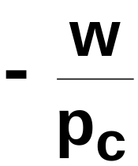
Labor Supply
C
⎯
⎯
slope = , the ‘real wage rate’
m
endowment
⎯
R
R

Slide 10
Labor Supply
C
⎯
⎯
C*
m
endowment
⎯
R
R*
R
leisure
demanded
labor
supplied

Slide 11
Comparative Statics of Labor Supply
What happens to labor supply when non labor income increases?
What happens to labor supply when real wage rates change? Key to understand the bizarre backward bending supply curve.

Slide 12
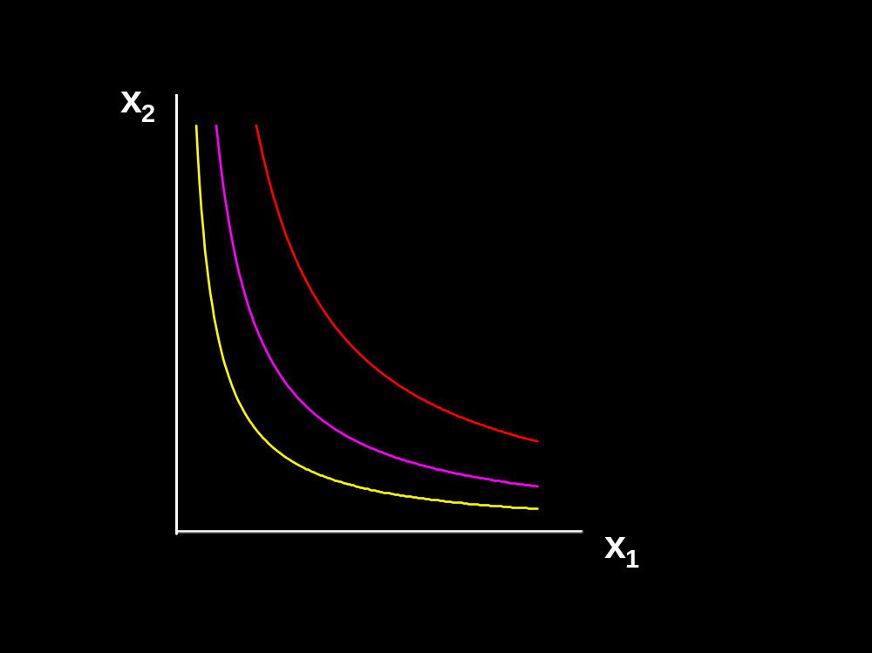
Non-labor Income Changes
Fixed p and w
C’’
C’
R’’
⎯
R
R’

Slide 13
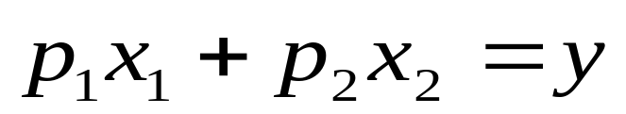
Wage Rate Changes
Slutsky: changes to demands caused by a price change are the sum of
  a pure substitution effect, and
  an income effect.
This assumed that income y did not change as prices changed.
But in the labor supply case, the income does change with price. How does this modify Slutsky’s equation?

Slide 14
Slutsky’s Equation Revisited
In the labor supply case, a change in w changes
so there will be
an additional income effect, called the endowment income effect （禀赋收入效应）.
Slutsky’s decomposition will thus have three components
  a pure substitution effect
  an (ordinary) income effect, and
  an endowment income effect.
⎯

Slide 15
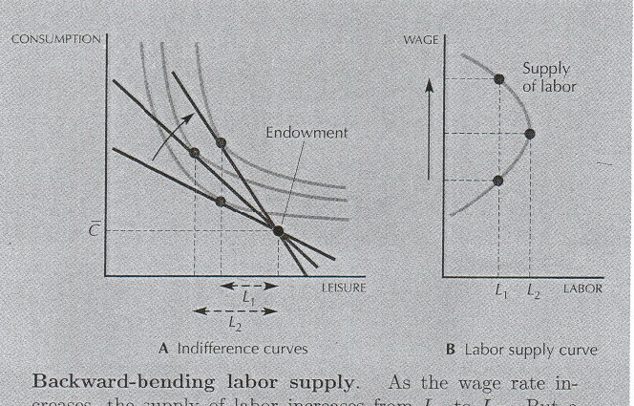
Labor Supply Curve

